Slide 1

CSC 533: Privacy in the Digital Age (Fall 2020) Lecture 8: Stateful Online Tracking
Anupam Das
Sept. 8, 2020

Slide 2
Topic: Online Privacy
Learning Objectives:
What it means by online tracking?
Different mechanism for online tracking
Stateful tracking
Stateless tracking
Ways to prevent online tracking
Anonymous online communication systems
Social network privacy

Slide 3
Goals for today
What is online tracking?
Stateful tracking (cookie based tracking)
Within- and cross-site tracking
Some contents are borrowed from online material provided by Nataliia Bielova and Franziska Roesner

Slide 4
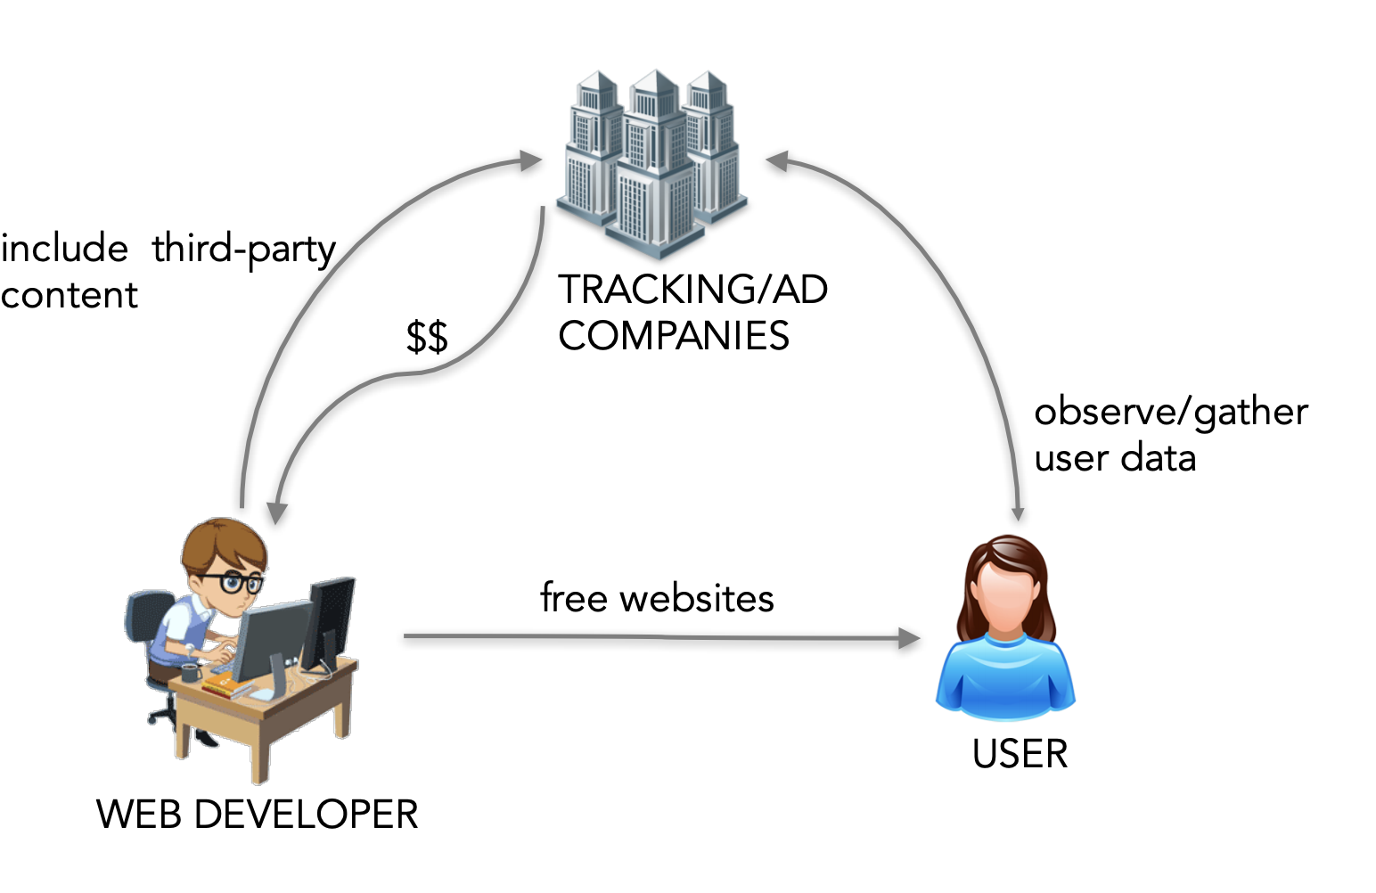
Business model of the Web
Site operators earn through serving ads or third-party tracking content

Slide 5




Web tracking is prevalent
Creates your digital footprint

Slide 6




How does web tracking work?
google-analytics.com
Bigger browsing profiles
= increased value for trackers
= reduced privacy for users
doubleclick.com
quantserve.com
(Hypothetical tracking relationships only.)
Courtesy of Franziska Roesner

Slide 7




How does web tracking work?
Issues:
Collection of our data without our knowledge
on sensitive websites
collection of our browsing patterns, preferences, tastes, even mood…
Can be misused by insurance company or govt.
Ad network
Ad space of doubleclick
doubleclick.com
Real-time-bidding (RTB)
Advertisers

Slide 8
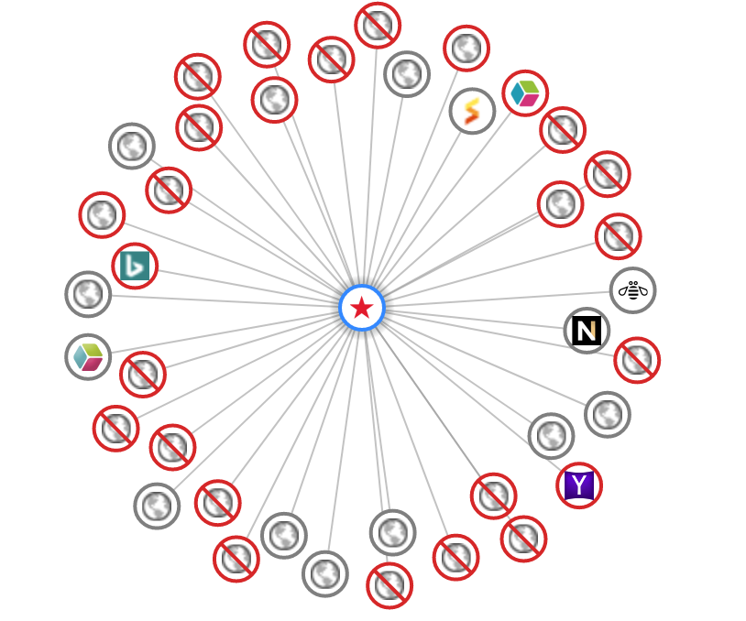
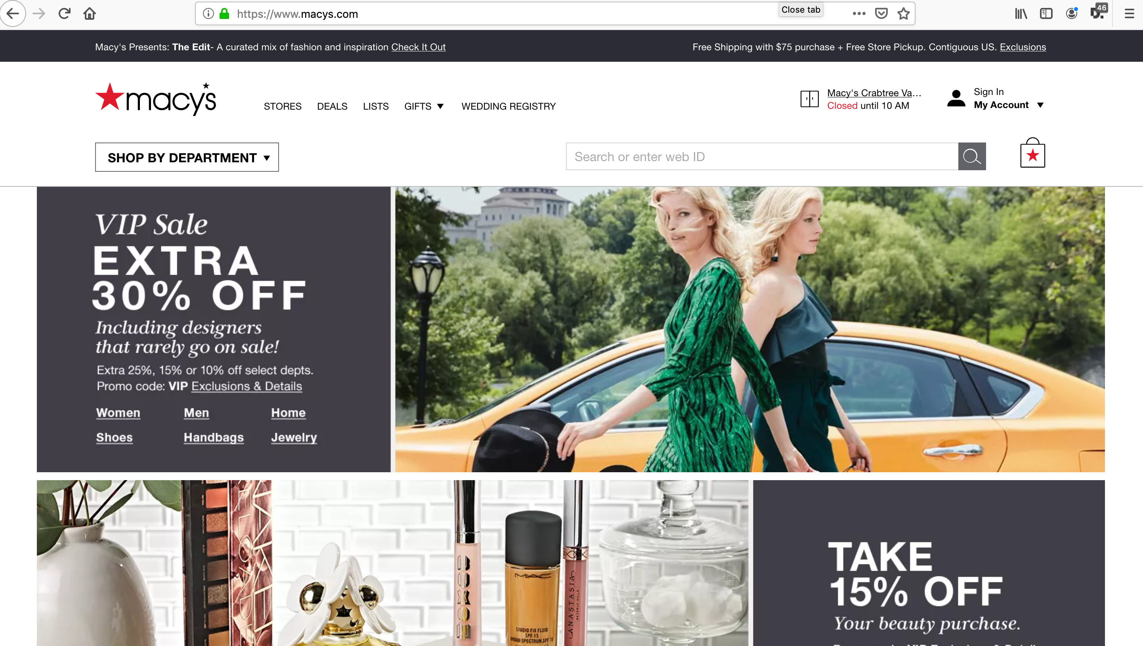
How many trackers per website?
46 trackers

Slide 9
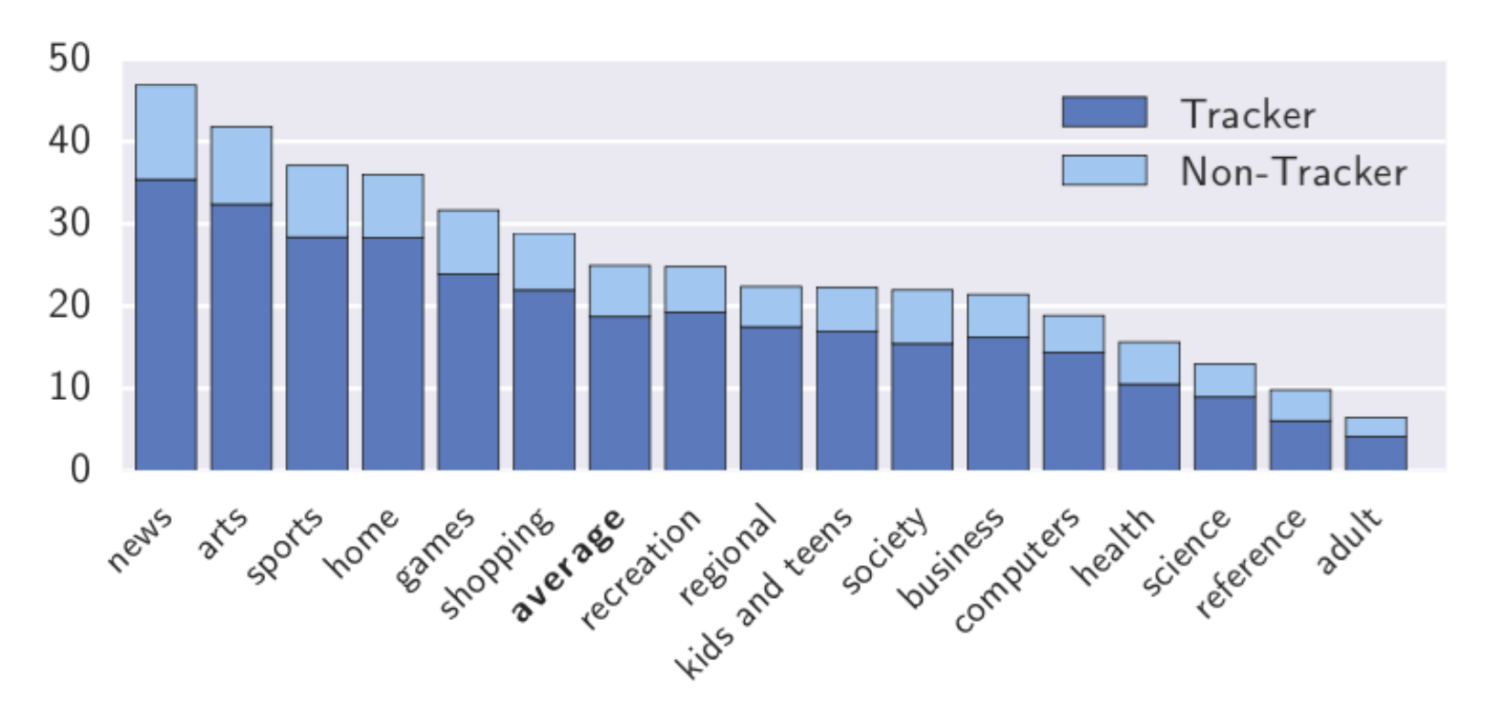
How many trackers per website?
Englehardt& Narayanan. Online Tracking: A 1-million-site Measurement and Analysis. ACM CCS 2016

Slide 10
Where is the problem?
Users have no control over their data!
Disproportion between the data collected and data actually used for functionality

Slide 11


How HTTP and Cookies work?

Slide 12
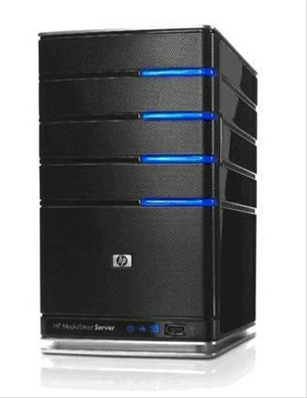
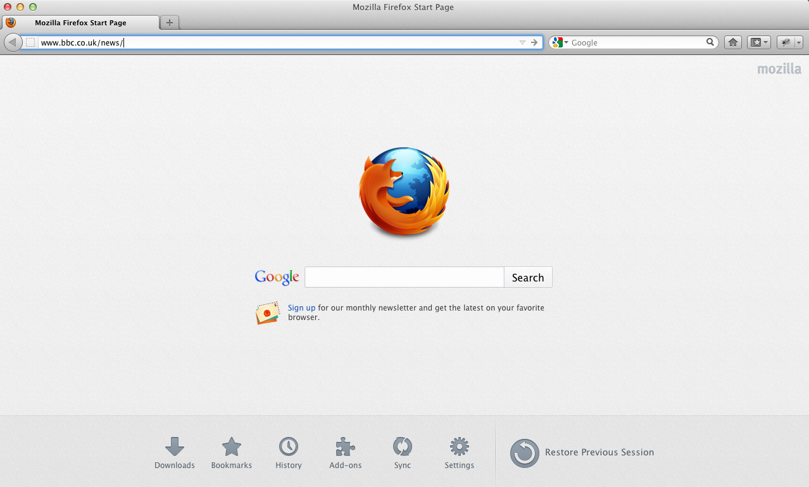
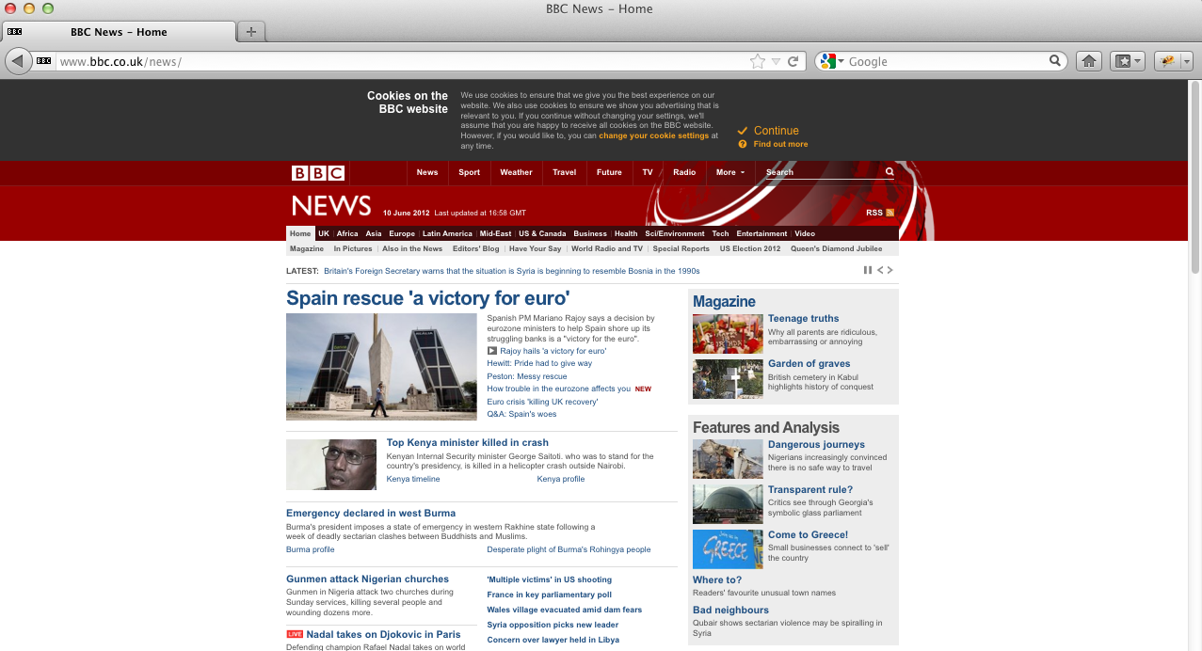
HTTP: HyperText Transfer Protocol
URL path: bbc.co.uk/news
Parameters
Method: GET
…
Web browser
Web server
HTTP request
HTTP response
Status: 200 OK
Content: HTML page
…
- Rendering pages
- Executing scripts/plugins (JavaScript)
- Launching new HTTP requests
- Mapping requests to apps
- Contacting DBs
- Constructing responses
Notes:
HTTP is stateless, one HTTP request is not coupled with the previous one
Cookies are used for a web session, but also to track the users that come back!

Slide 13
HTTP: HyperText Transfer Protocol
HTTP important characteristic: no State per request/response - each request is independent
HTTP header: header section of requests and responses, parameters of the HTTP transaction
Notes:
HTTP is stateless, one HTTP request is not coupled with the previous one

Slide 14
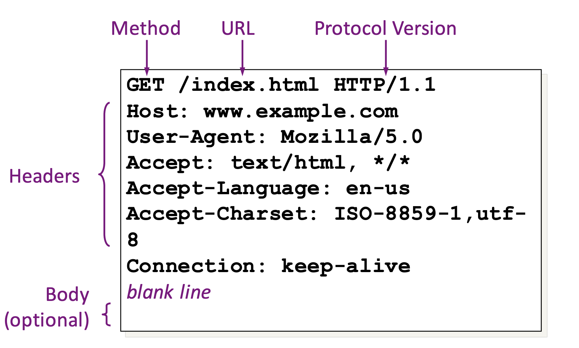
HTTP: Request

Slide 15
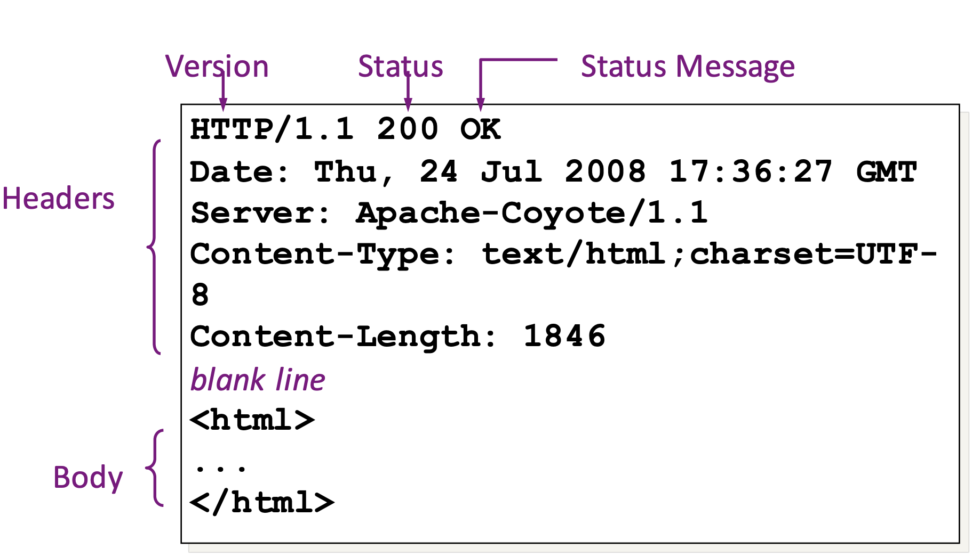
HTTP: Response

Slide 16
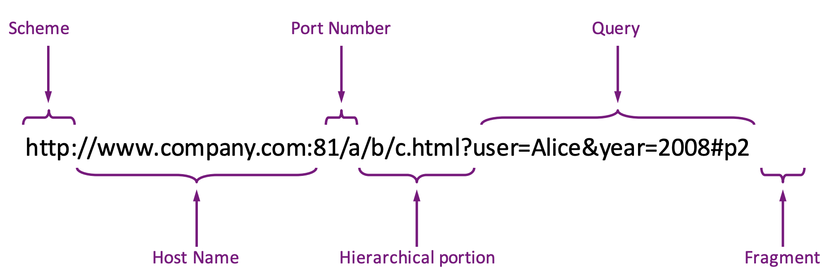
Uniform Resource Locators (URLs)

Slide 17
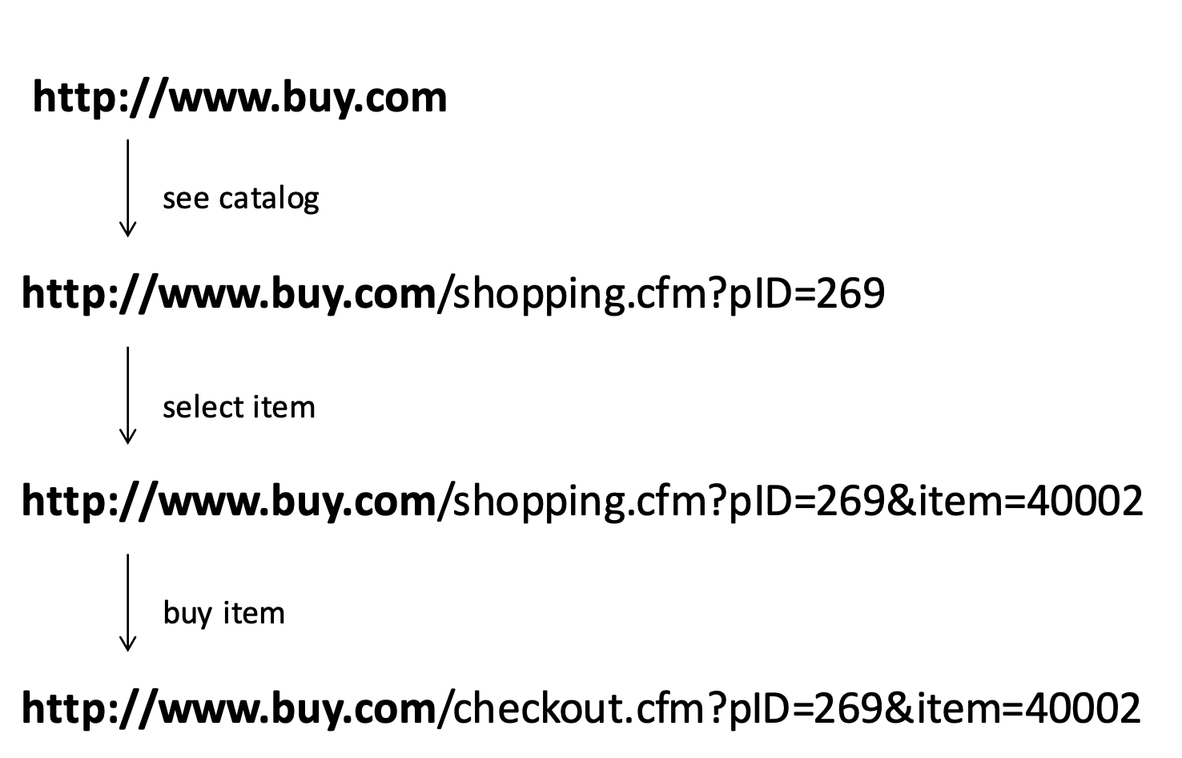
How to keep state in Web applications?
HTTP: Session in URL Example
Since HTTP is stateless -- session information is saved in the URL!

Slide 18
HTTP: Session in cookies
URL path: bbc.co.uk/news
Parameters
Method: GET
…
Web browser
Web server
HTTP request
HTTP response
Cookie Database
Status: 200 OK
Content: HTML page
Set-cookies: session-id=2082787201l & …
…
bbc.co.uk/news:
session-id=2082787201l
Notes:
HTTP is stateless, one HTTP request is not coupled with the previous one
Cookies are used for a web session, but also to track the users that come back!

Slide 19
HTTP: Session in cookies
URL path: bbc.co.uk/news...
Method: GET
Cookies: session-id=2082787201l & …
…
Web browser
Web server
HTTP request
Cookie Database
bbc.co.uk/news:
session-id=2082787201l
Notes:
HTTP is stateless, one HTTP request is not coupled with the previous one
Cookies are used for a web session, but also to track the users that come back!

Slide 20
What is a cookie?
A small piece of data, sent by the HTTP server in an HTTP response, stored by the client, and sent back by the client to the server in all further responses.
A cookie may also be set and read directly in the client by some JavaScript code.

Slide 21
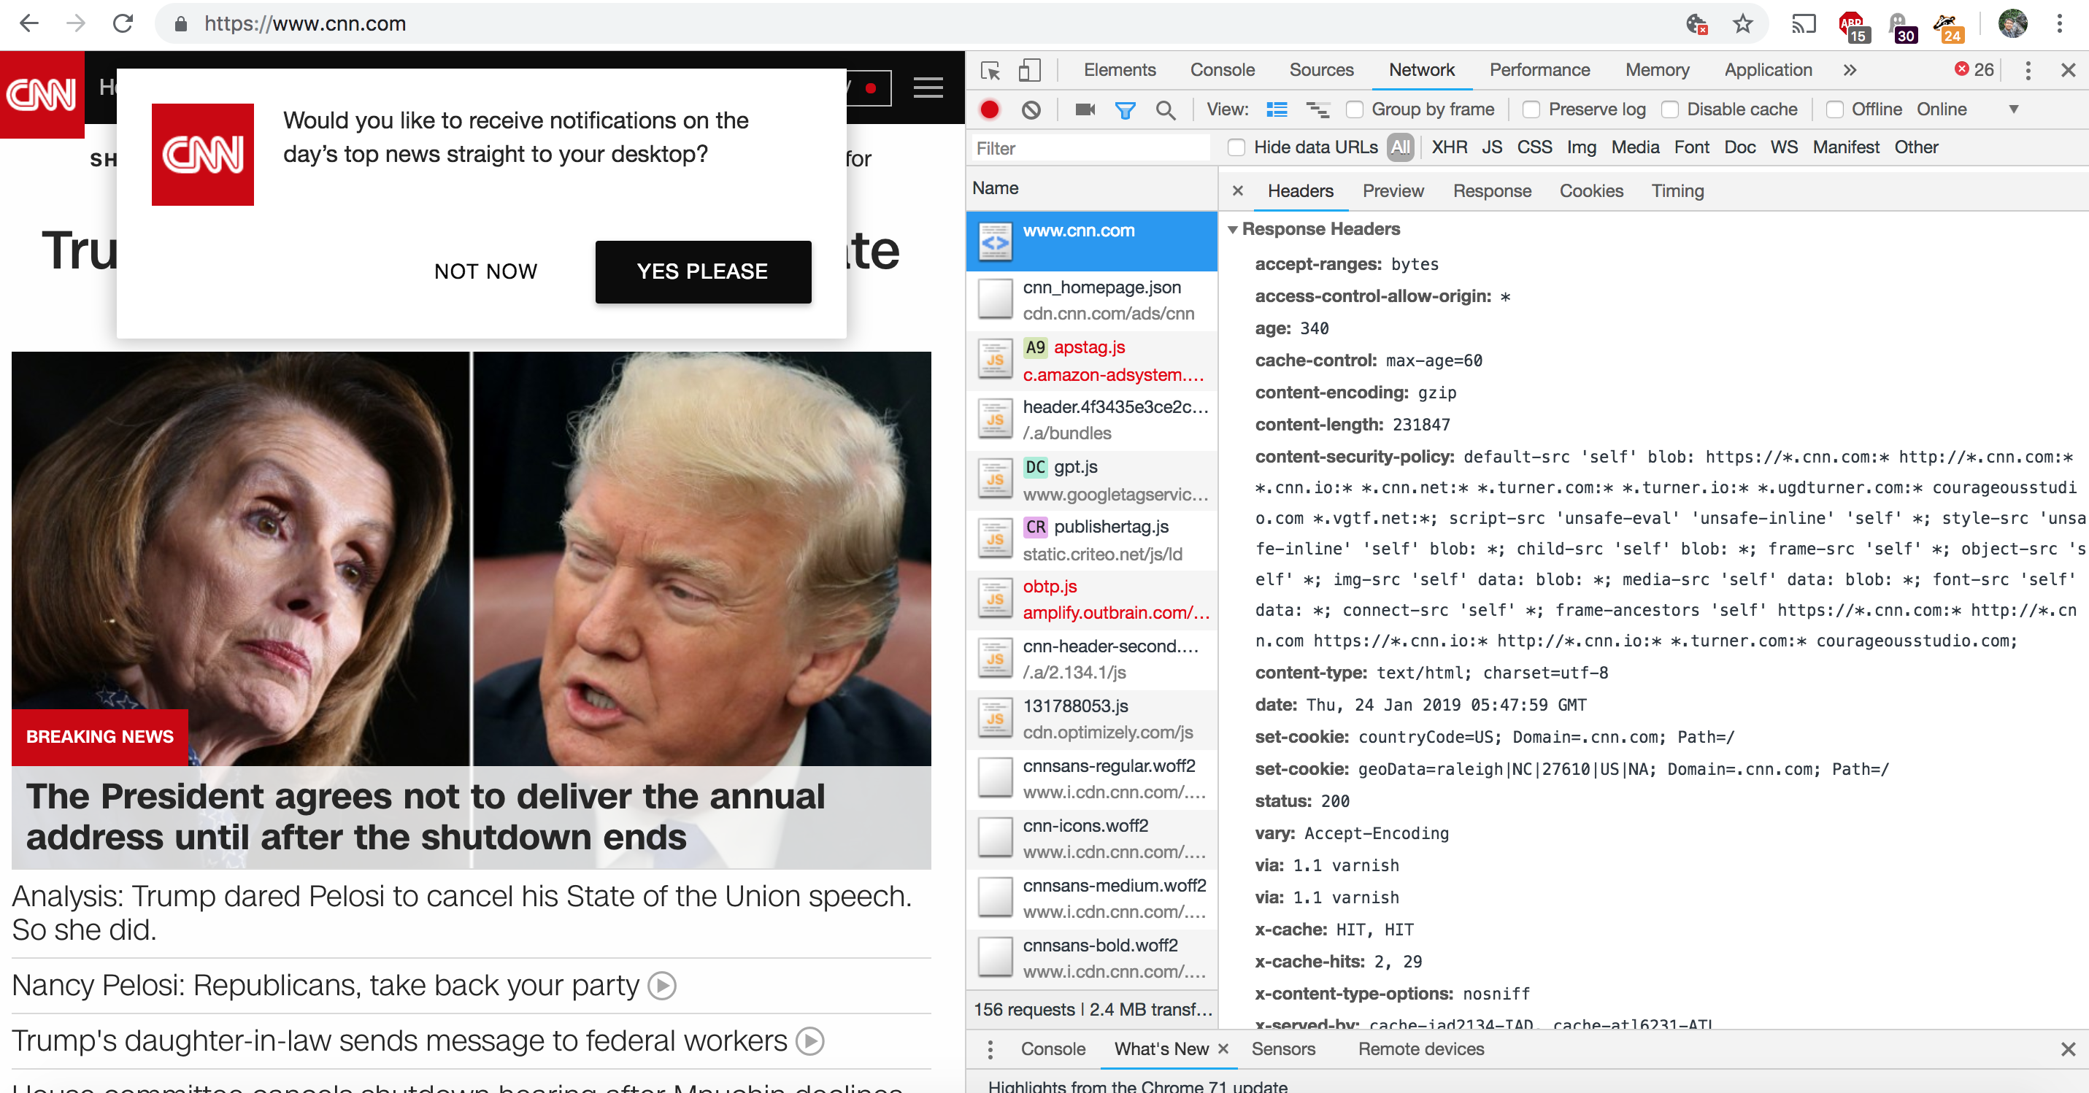
How a cookie looks like inside a header?

Slide 22
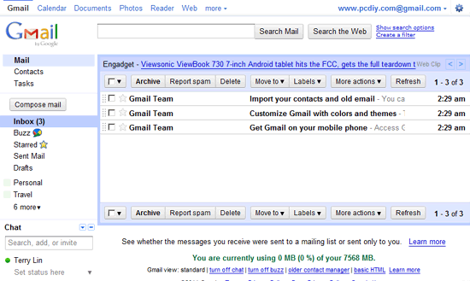
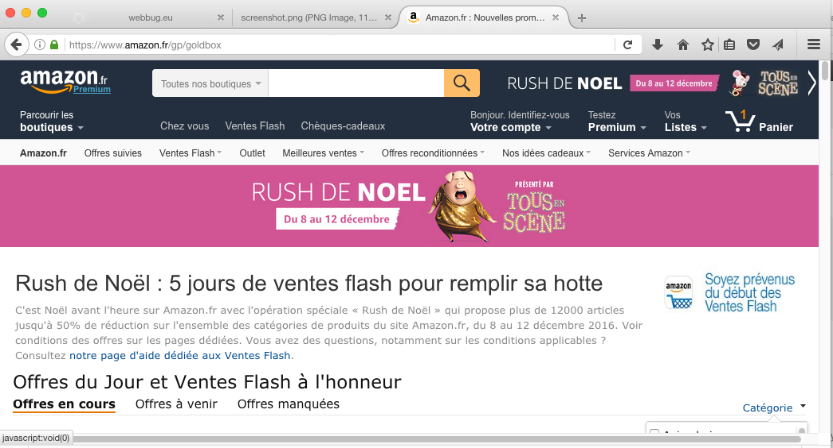
What’s the original use of cookies?
Keep the session through different windows/tabs
Shopping basket

Slide 23
Profitable uses of cookies
Personalization: remember the information about the user who has visited a website in order to show relevant content in the future
Tracking: following the user during a session or across multiple visits.

Slide 24
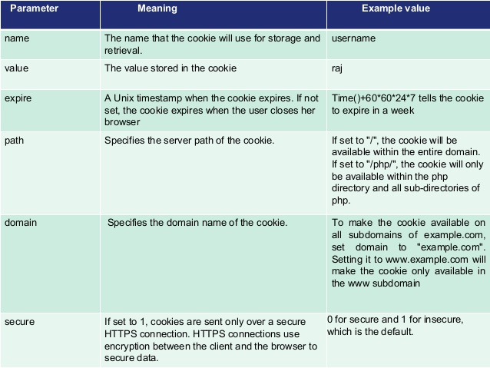
What’s inside a cookie?
If set to ‘/’ available in the entire domain.
If set to say ‘/php/’ only available within ‘php’ and its subdirectories
To make the cookie available on all subdomain set domain to top-level domain

Slide 25
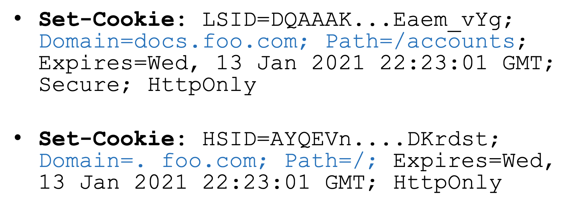
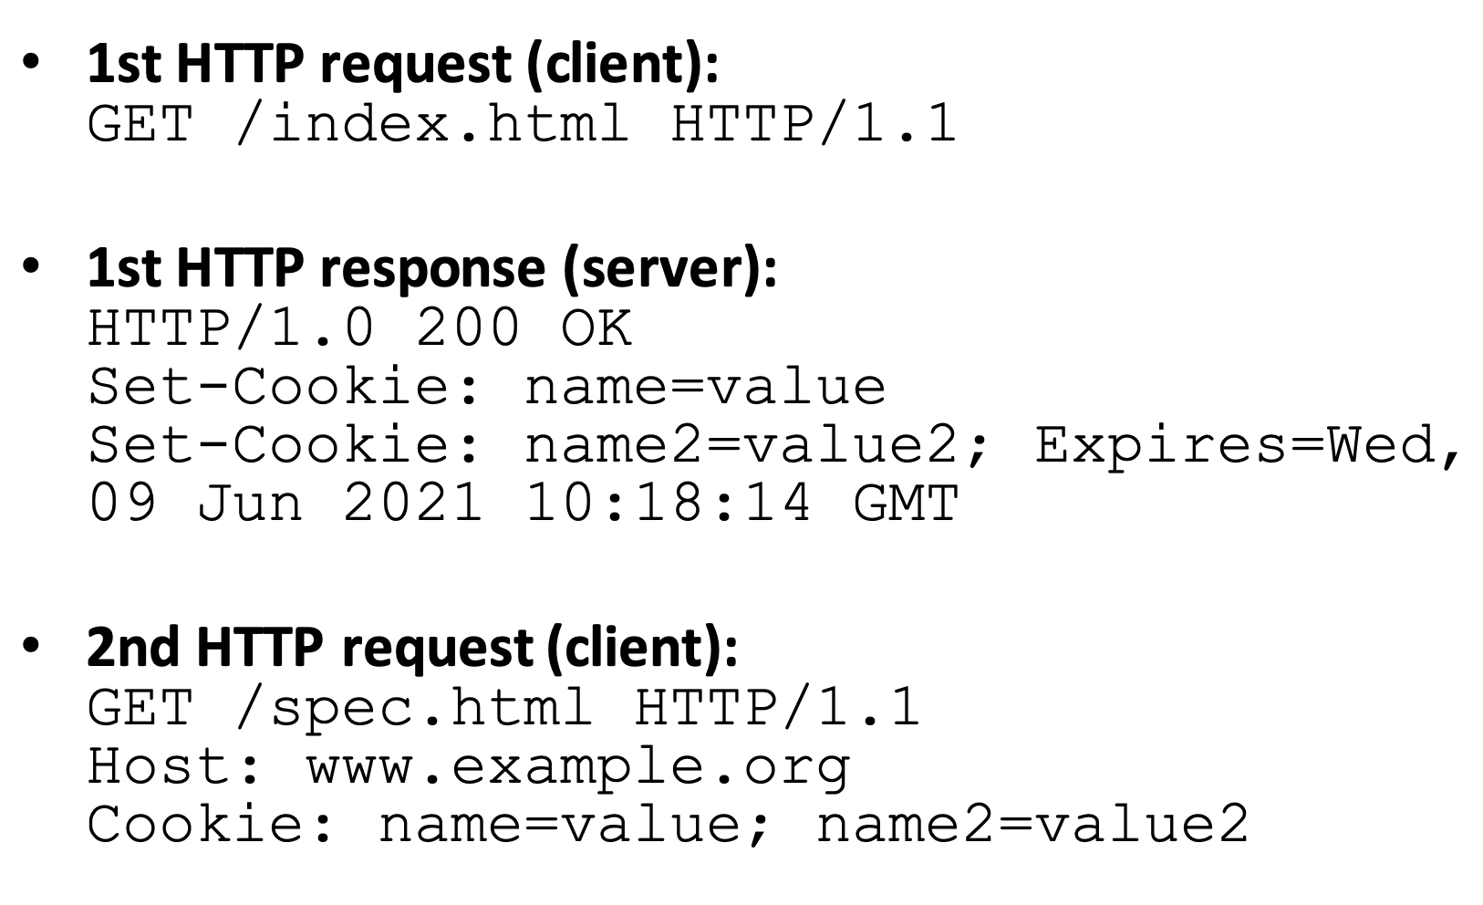
First-party cookie setting

Slide 26
Types of cookies
Session cookie: cookie without expiry date. Disappears when the browser is closed.
Persistent cookie: cookie with an expiry date. Remains until this date, even if the browser is closed.
Secure cookie: sent only in HTTPS requests.
HttpOnly cookie: non-accessible from JavaScript.
Third-party cookie: a cookie from another domain than the domain that is shown in the browser's address bar.

Slide 27
Mechanisms Required By Trackers
Ability to create/store user identity in the browser
HTTP cookies
HTTP headers
browser storages
device fingerprinting:
browser properties
OS properties
IP address…
Ability to communicate user identity back to tracker
HTTP requests by the browser (includes referrer information)
fetch a new image
JavaScript
XMLHttpRequest
Stateful tracking
Stateless tracking
J. Mayer, J. Mitchell “Third-party web tracking: Policy and Technology” IEEE S&P 2012

Slide 28
Tracking via Cookies (Stateful tracking)

Slide 29
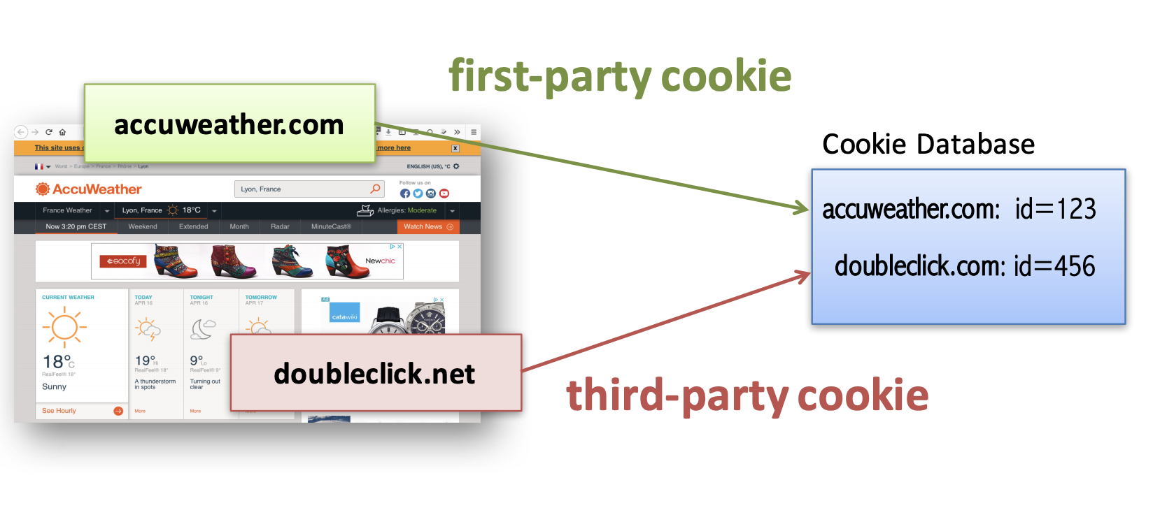
Cookies: first- and third-party

Slide 30
Within-Site Tracking
First-party cookies are used to track repeat visits to a site.
[Can do their own on-site analytics or use third-party analytics]
Site1.com
http://site1.com
<script src=site1.com/script.js>
</src>
processing engine
Cookie Database
2:52pm: user 123 visited site1.com
site1.com:
ga_id=123
script
site1.com/track?ga_id=123&
site=site1.com
logs
Based on the slide of Franziska Roesner

Slide 31
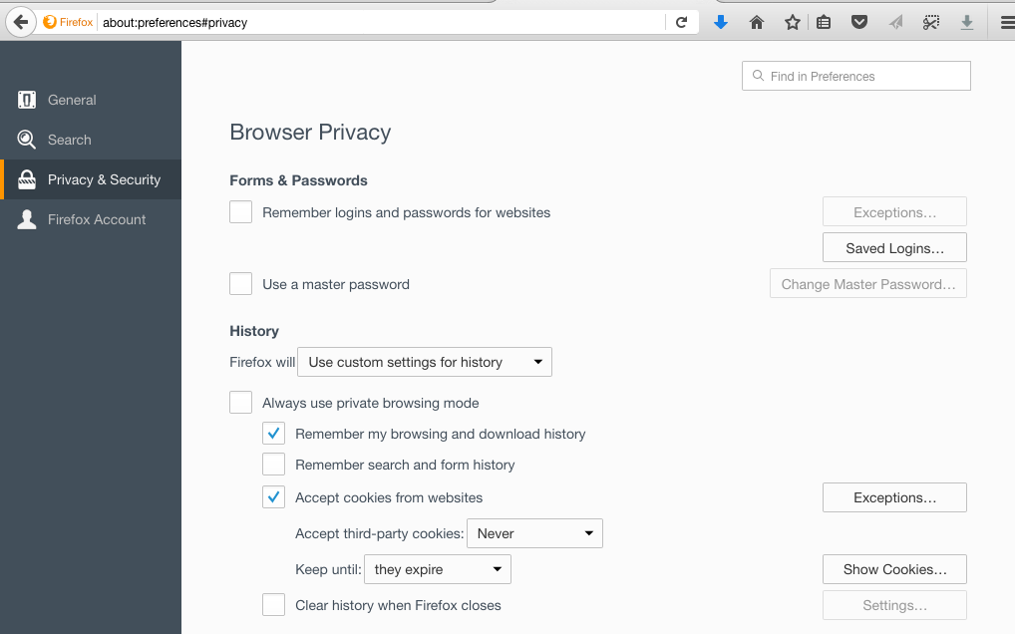
First-party cookie setting

Slide 32

First-party cookies have more benefits
Website owners can evaluate
website statistics
popularity of certain pages
popularity of links
selected and copied phrases

Slide 33
Cross-site Tracking
Third-party cookies are used to track users across sites and collect their browsing history.
tracker.com
http://site1.com
http://site2.com
cookie: id=789
<iframe src=tracker.com/ad.html>
</iframe>
processing engine
Cookie Database
9:30am: user 789 visited site1.com
ad
cookie: id=789
tracker.com: id=789
9:31am: user 789 visited site2.com
logs
Courtesy of Franziska Roesner
Roesner et al. “Detecting and Defending Against Third-Party Tracking on the Web” NSDI 2012

Slide 34
Third-party cookies blocking

Slide 35
What if I block third-party cookies?
Option blocks the setting of third-party cookies: all browsers
Option blocks the sending of third-party cookies: only in Firefox and Chrome
Result: Once a third-party cookie is somehow set, it can be used (in Internet Explorer).
Roesner etal “Detecting and Defending Against Third-Party Tracking on the Web”
NSDI’2012

Slide 36
Forced Cross-sites Tracking
http://site1.com
tracker.com
<iframe src=tracker.com/ad.html>
</iframe>
processing engine
Cookie Database
ad
popup
(acts as 1st party now)
cookie: id=321
tracker.com: id=321
cookie: id=321
http://site2.com
logs
<iframe src=tracker.com/ad.html>
</iframe>
1:30pm:
site1.com: user 321
ad
1:31pm:
site2.com: user 321
Courtesy of Franziska Roesner

Slide 37
Referred Cross-sites Tracking
http://site1.com
tracker.com
<iframe src=tracker.com/ad.html>
</iframe>
processing engine
Cookie Database
ad
tracker.com: id=522
cookie: id=522
othertracker.com/track?id=522&referrer=site1.com
http://site2.com
cookie: id=522
othertracker.com
<iframe src=tracker.com/ad.html>
</iframe>
processing engine
logs
2:34pm:
site1.com: user 522
ad
2:35pm:
site2.com: user 522
othertracker.com/track?id=522&referrer=site2.com
Courtesy of Franziska Roesner

Slide 38
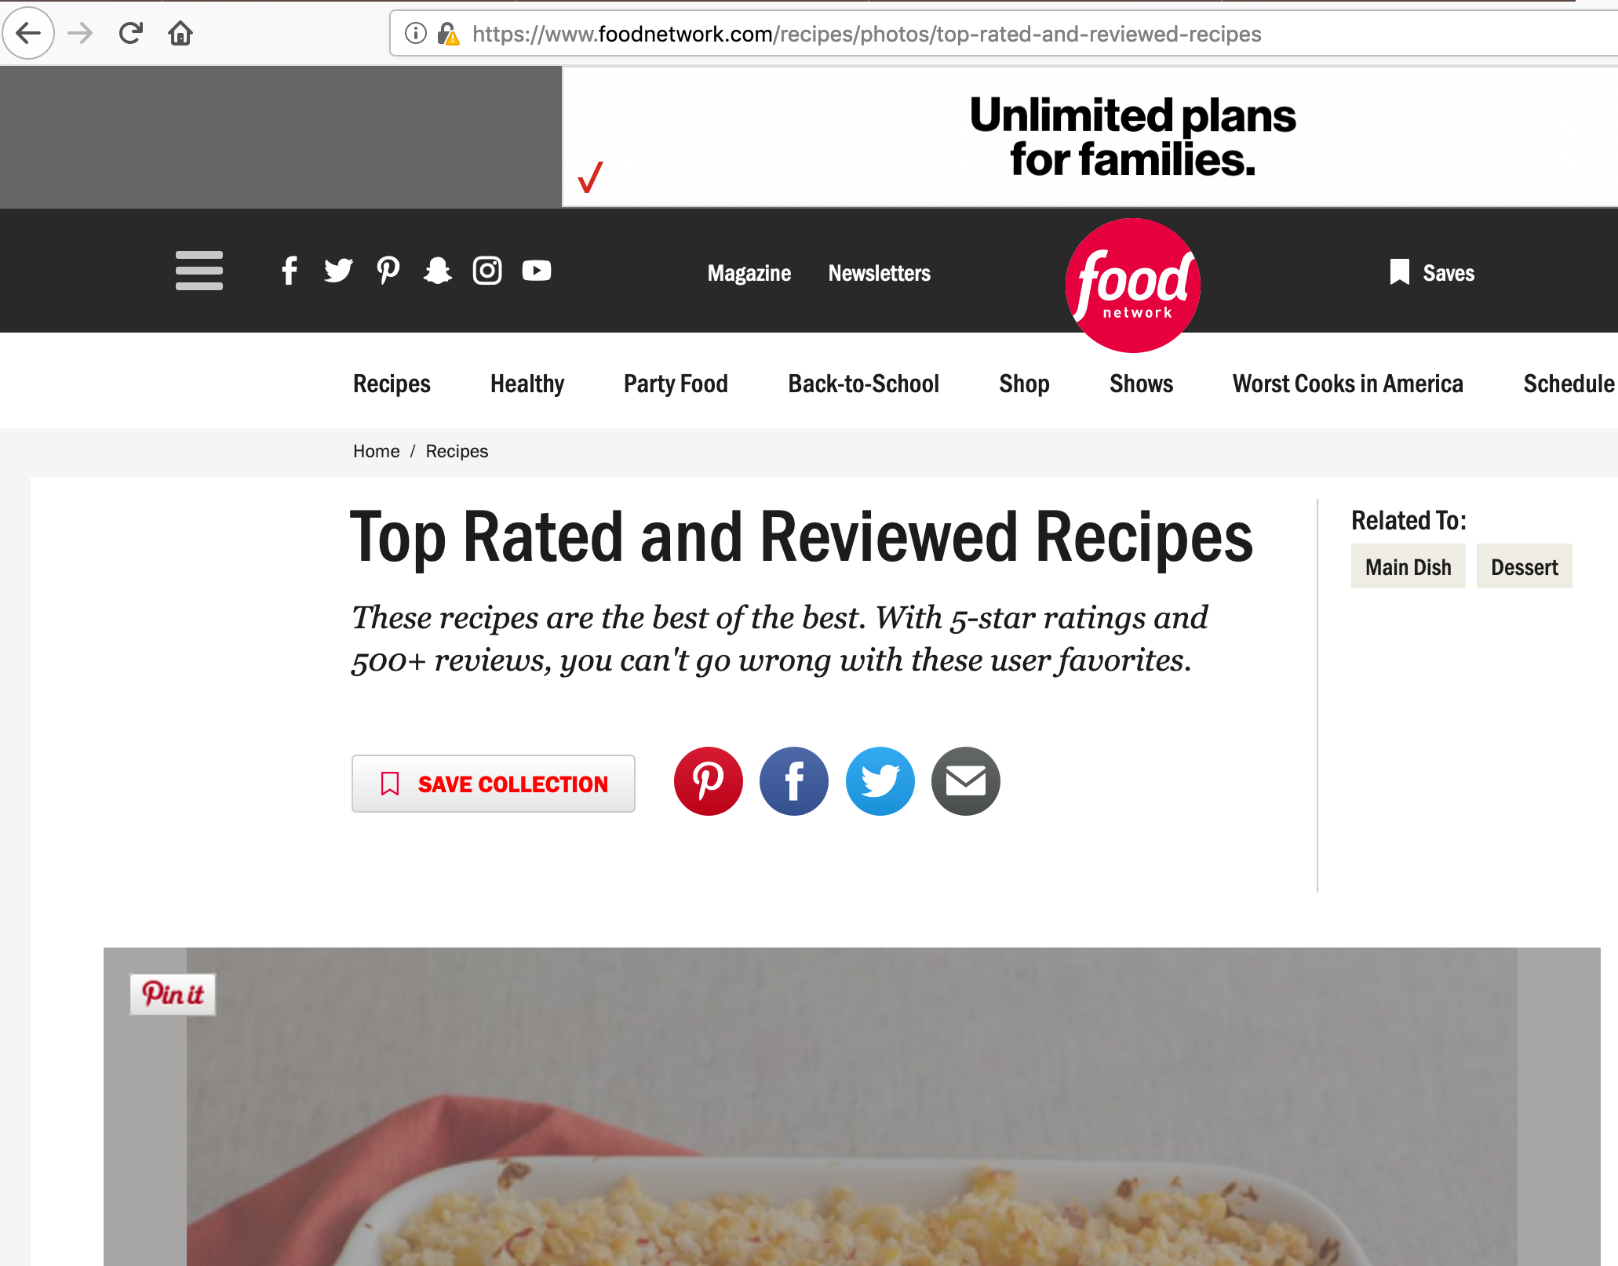
Social buttons
Just loading these buttons (not clicking on them) enables tracking.
Users visit these sites directly.
This tracking is often not anonymous (linked to accounts).

Slide 39

Personal Cross-Site Tracking
http://facebook.com
facebook.com
processing engine
First-party site
Cookie Database
facebook.com: fb_id=522
cookie: fb_id=522
logs
cookie: fb_id=522
2:34pm: user 522 visited facebook.com
http://site.com
2:35pm: user 522 visited site.com
<iframe src=faceboook.com/button.html>
</iframe>

Slide 40
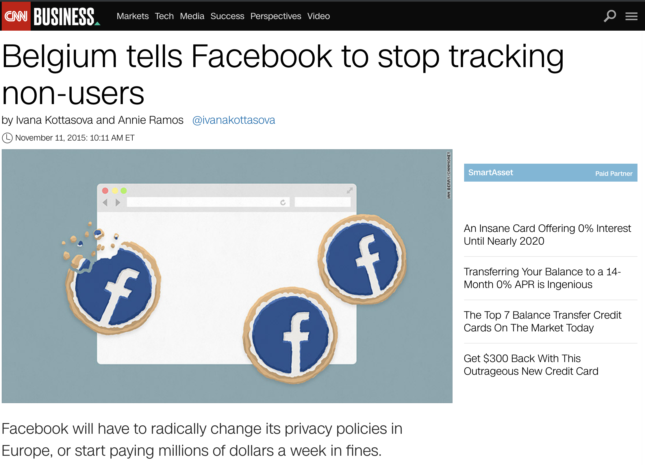


2015
possible bcz of third-party tracking
2019
2018

Slide 41
Cookie based tracking: summary
Type (Name) | Scope | User Visits Directly? | Overview
1st party | Within-Site | Yes | Site does its own on-site analytics.
Analytics | Within-Site | No | Site uses third-party analytics engine (e.g., Google Analytics).
Vanilla | Cross-Site | No | Site embeds third-party tracker that uses third-party storage (e.g., Doubleclick).
Forced | Cross-Site | Yes (forced) | Site embeds third-party tracker that forced the user to visit directly (e.g., via popup).
Referred | Cross-Site | No | Tracker relies on another cross-site tracker to leak unique identifier values.
Personal | Cross-Site | Yes | Site embeds third-party tracker that the user otherwise visits directly (e.g., Facebook).
Evolution: Embedding analytics libraries
Evolution: Third-party cookie blocking
Evolution: Complex ad networks
Evolution: Social networks

Slide 42
Third-party cookie blocking problem
Important detail:
In some browsers, third-party cookie blocking option doesn’t block sending the cookies
Privacy problems:
If a tracker can ever set a cookie, third-party cookie blocking is rendered ineffective.
The user can be tracked just because a site she visits contains a social button

Slide 43
Cookie respawning (Aka Zombie cookies

Slide 44

Cookie respawning (Aka Zombie cookies)
Cookies can respawn even if the user has deleted them
HTML5 localStorage (across sessions only)
Flash LSOs (across sessions and web browsers)
HTTP headers: Etag, LastModified
A. Soltani http://ashkansoltani.org/2011/08/11/respawn-redux-flash-cookies/

Slide 45
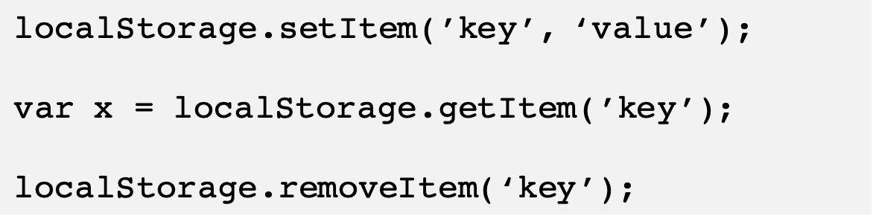
HTML5 localStorage
HTML5 localStorage allows to store pairs of strings key + value
localStorage has no expiration date

Slide 46
Difference between cookies and localstorage
Cookies:
They add to the load of every document accessed on the domain.
They allow up to only 4 KB of data storage.
Localstorage:
must be explicitly accessed
localStorage.setItem,localStorage.getItem
Maximum data storage 5120KB

Slide 47
Respawning via HTML5 localStorage
User leaves the page
tracker.com
http://site1.com
Cookie Database
<iframe src=tracker.com/ad.html>
</iframe>
processing engine
tracker.com: id=789
9:30am: user 789 visited site1.com
script
cookie: id=789
HTML5 localStorage
logs
tracker.com: id=789

Slide 48
Respawning via HTML5 localStorage
User deletes all the cookies!
tracker.com
http://site2.com
Cookie Database
<iframe src=tracker.com/ad.html>
</iframe>
processing engine
cookie: id=555
tracker.com: id=789
tracker.com: id=555
9:30am: user 789 visited site1.com
script
9:31am: user 555 visited site2.com
HTML5 localStorage
logs
tracker.com: id=789

Slide 49
Respawning via HTML5 localStorage
User deletes all the cookies!
tracker.com
http://site2.com
Cookie Database
<iframe src=tracker.com/ad.html>
</iframe>
processing engine
789
cookies:
old_id = 555, new_id=789
tracker.com: id=555
9:30am: user 789 visited site1.com
script
9:31am: user 789 visited site2.com
9:31am: user 555 visited site2.com
HTML5 localStorage
logs
tracker.com: id=789

Slide 50
Respawning via Flash Local Stored Objects (LSOs)
File *.sol stored in user’s machine
Mac OS location: ~/Library/Preferences/Macromedia/Flash Player/#SharedObjects
Accessible through the ActionScript program in *.swf
ActionScript is an object-oriented programming language originally developed by Macromedia Inc.
The first Web tracking across browsers!

Slide 51

Good news
Flash plugin is progressively disappearing
Adobe announced it will officially end development of the Adobe Flash Player at the end of 2020

Slide 52
Respawning via Etag header
ETag HTTP header is a caching mechanism
A.com
GET: A.com
200 OK
Etag: “x234dff”, max-age=120
Resource cache
(html body)
A.com:
token = “x234dff”
GET: A.com
If-None-Match: “x234dff”
(html body)
A.com has
not changed
304 Not Modified
Etag: “x234dff”

Slide 53
Respawning via ETag header
No specific recommended way of storing Etags. Typically in browser cache (HTTP cache must be enabled). Disabling cache may result in not storing Etags.
INITIAL REQUEST HEADER:
GET /i.js HTTP/1.1
Host: i.kissmetrics.com
INITIAL RESPONSE HEADER:
Etag: "Z9iGGN1n1-zeVqbgzrlKkl39hiY"
Expires: Sun, 12 Dec 2038 01:19:31 GMT
Last-Modified: Wed, 27 Jul 2011 00:19:31 GMT
Set-Cookie: _km_cid=Z9iGGN1n1-zeVqbgzrlKkl39hiY;
expires=Sun, 12 Dec 2038 01:19:31 GMT;path=/;
SUBSEQUENT REQUEST HEADER (PRIVATE BROWSING MODE WITH ALL COOKIES BLOCKED):
GET /i.js HTTP/1.1
Host: i.kissmetrics.com
If-None-Match: "Z9iGGN1n1-zeVqbgzrlKkl39hiY"
KISSmetrics (analytics company) settled a class lawsuit in August 2011
Two major Web companies, Hulu and Spotify, suspended use of KISSmetrics

Slide 54
Not Respawning, but Tracking
Important detail:
If ETag header, HTML5 localStorage, or Flash LSO didn’t store a copy of cookies => tracking would not be detected!
Privacy problem:
All of these storages can be used for tracking without cookies

Slide 55
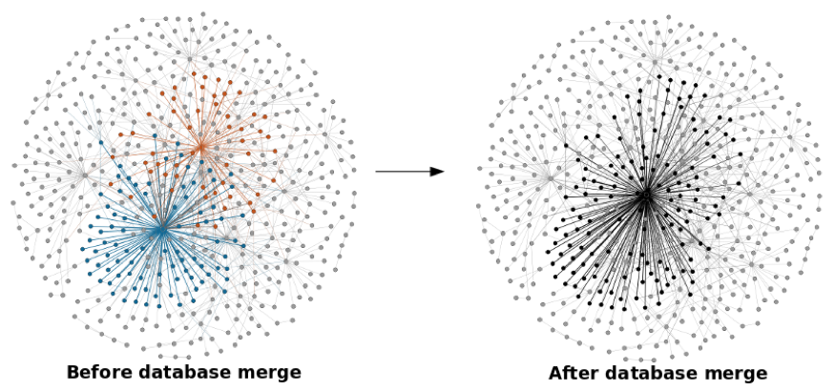
Cookie syncing provides a better picture
the process by which two different trackers link the IDs they’ve given to the same user
cookie is used in Real-time-bidding (RTB)
cookie syncing allows to construct a more precise user profile

Slide 56
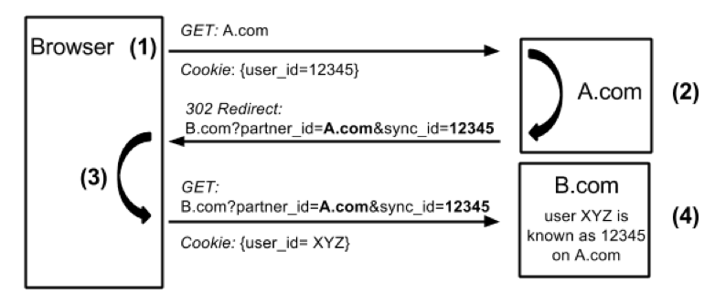
Cookie Syncing
Site A informs site B about user’s identity (via user’s browser)
Allows aggregation across multiple trackers
Acar et al. The Web Never Forgets: Persistent Tracking Mechanisms in the Wild, CCS’14

Slide 57
What if I delete all my cookies?
Important detail:
If at least one tracker respawns one cookie, he passes it to other trackers
Privacy problem:
Thus, even trackers that don’t employ respawning gain the ability to continually track users who clear cookies!

Slide 58
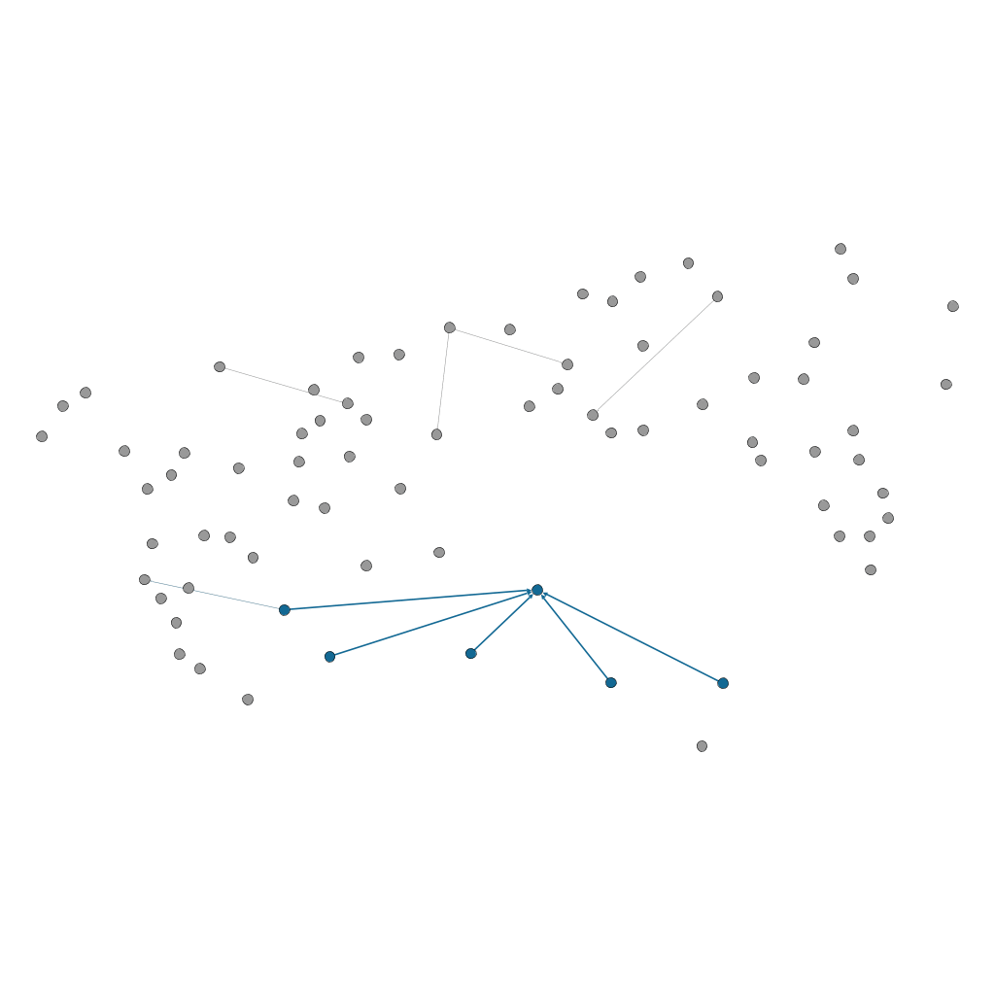
Cookie syncing graphically
Notes:
This graph shows what happens when a user visits several hundred of the top 1500 sites in a random order but clears cookies midway⁵. Nodes represent pages visited or embedded third-party trackers and edges represent a tracked visit. We highlight the same tracker both before and after the user clears cookies (blue and orange respectively). The graph on the left is completely disconnected, meaning the user effectively appears as two different users to the trackers. But when this tracker receives respawned cookies via cookie syncing, they gain the ability to connect the user’s visits to websites they track from before and after cookie clearing.

Slide 59
Large-scale studies of Web tracking
Run a crawler on X Top Alexa websites
https://www.alexa.com/topsites
Collect all request/responses
For every request and response
Mark as “tracking” if a third-party cookie is set/sent
Mark as “analytics” if a first-party cookie is set/sent
Exclude cookies repeated through several measurements
Cookies stored as “first-party” become “third-party” in a different context – social button example

Slide 60
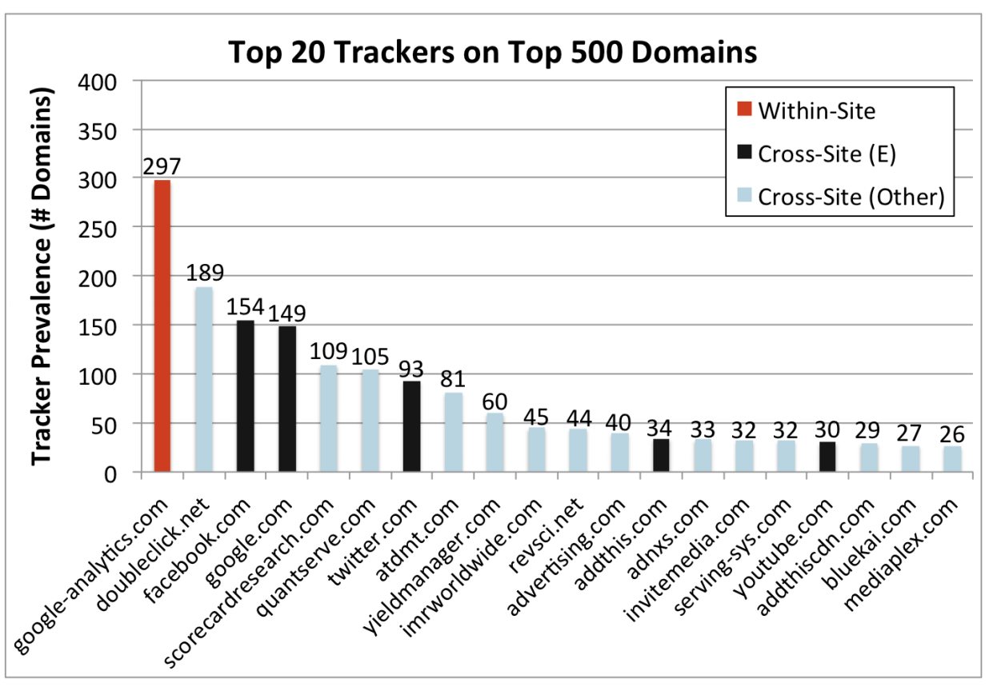
Classifying Web Tracking Behavior
Roesner et al. Detecting and Defending Against Third-Party Tracking on the Web USENIX NSDI 2012

Slide 61
How to recognize tracking behavior?
No single methodology in research literature
Convention: use consumer protection lists
EasyList and EasyPrivacy blocking lists
Lists used in ad blocking extensions

Slide 62
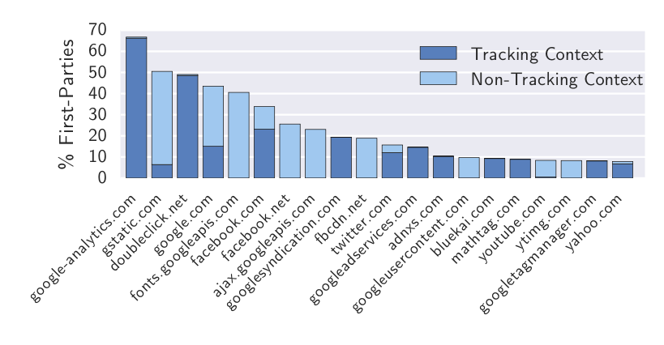
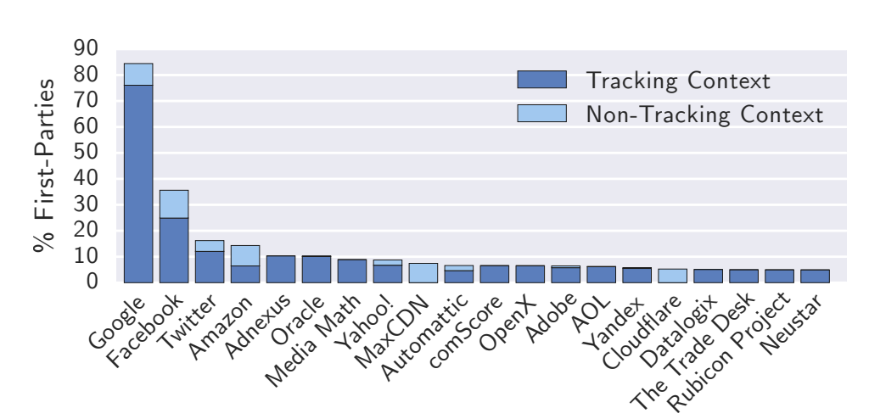
OpenWPM: 1 Million study
Google, Facebook, Twitter, and AdNexus are the only third-party entities present on more than 10% of sites.
Englehardt & Narayanan. Online Tracking: A 1-million-site Measurement and Analysis, CCS 2016

Slide 63
How did the tracking ecosystem change over time?

Slide 64
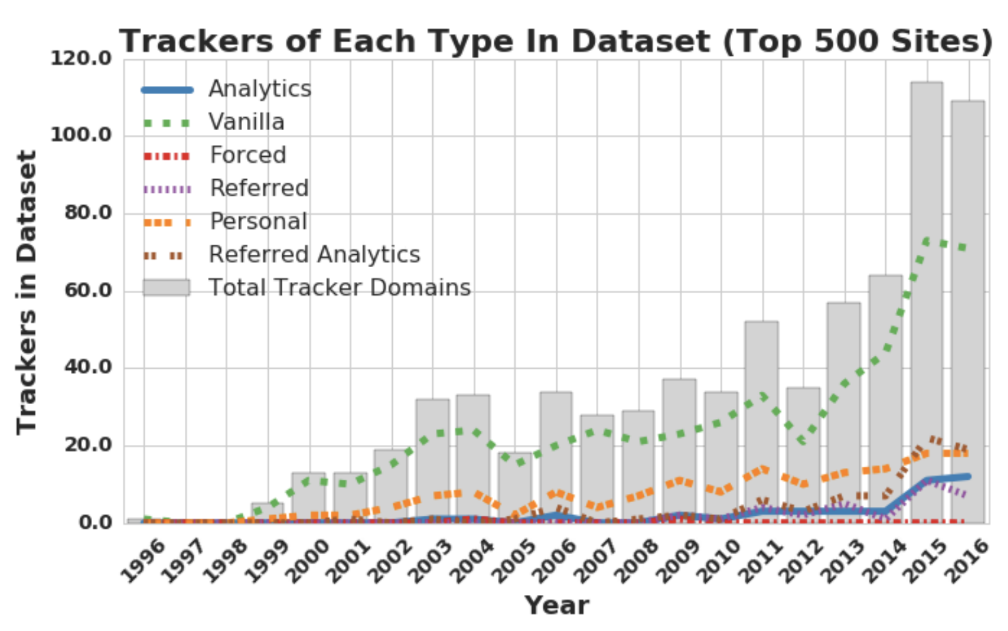
Longitudinal study
Lerner et al. Internet Jones and the Raiders of the Lost Trackers, USENIX Security 2016

Slide 65
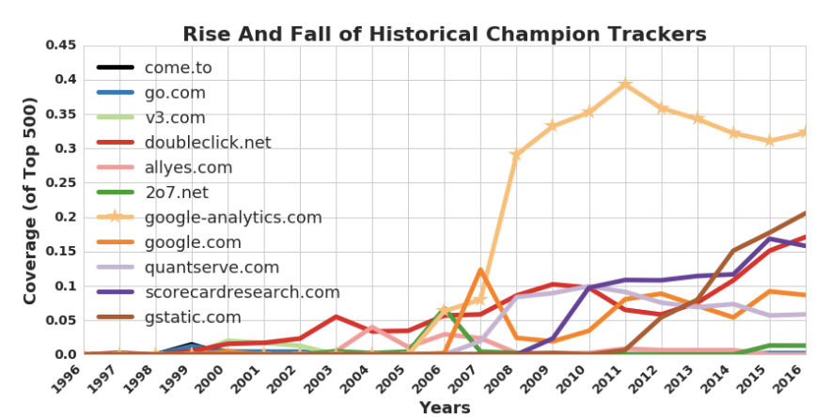
Longitudinal study
Lerner et al. Internet Jones and the Raiders of the Lost Trackers, USENIX Security 2016

Slide 66
Takeaway
Few domains are present on more than 30% of the Web
Third-party cookie blocking doesn’t effectively protect from Web tracking
The power of individual trackers has grown over time.
Conclusions:
Individual companies' choices are important to user’s privacy.
More transparency research is needed.

Slide 67
Interesting video
Detecting and Defending Against Third-Party Tracking on the Web: Franziska Roesner
https://www.usenix.org/conference/nsdi12/technical-sessions/presentation/roesner

Slide 68
Logistics
Homework 2 out
Due: Sept. 21@11:59pm

